Slide 1
MODULE B: AI AND MACHINE LEARNING
LECTURE 11-12
Md Mehrab Hossain Opi
Lecturer, Dept Of CSE, KUET

Slide 2
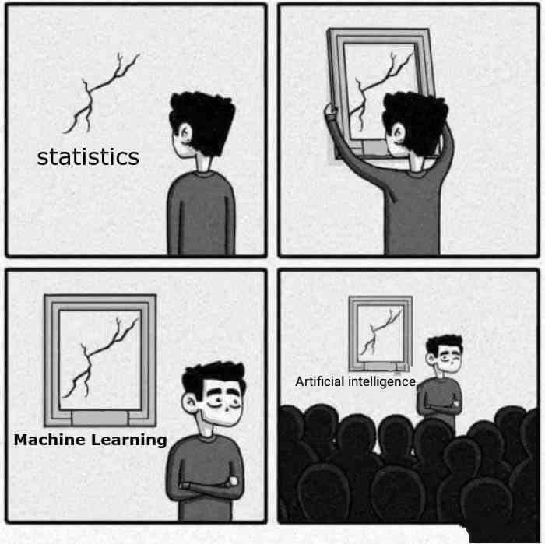
MACHINE LEARNING
Let’s start with a very simple question.
What is machine learning?
Combination of two words: ‘Machine’ and ‘Learning’.

Slide 3

MACHINE LEARNING
Any device that performs tasks or makes our lives easier.
It can be something as simple as a calculator or as complex as a self-driving car.

Slide 4

MACHINE LEARNING
And what is learning?
Gaining knowledge or skills from experience.
For us, it’s how we get better at things, like riding a bike or solving math problems.

Slide 5

MACHINE LEARNING
So , what is machine learning?
Machine learning combines these ideas – it’s about teaching a machine to do something better.
Based on experience.
But how does a machine gather experience?
How does a human gather experience?

Slide 6






MACHINE LEARNING
Humans learn by doing things repeatedly and remembering outcomes—like learning to cook a dish by trying, tasting, and adjusting.
Machine don’t see or feel like we do.
Instead, they learn by processing data – lots of it.

Slide 7
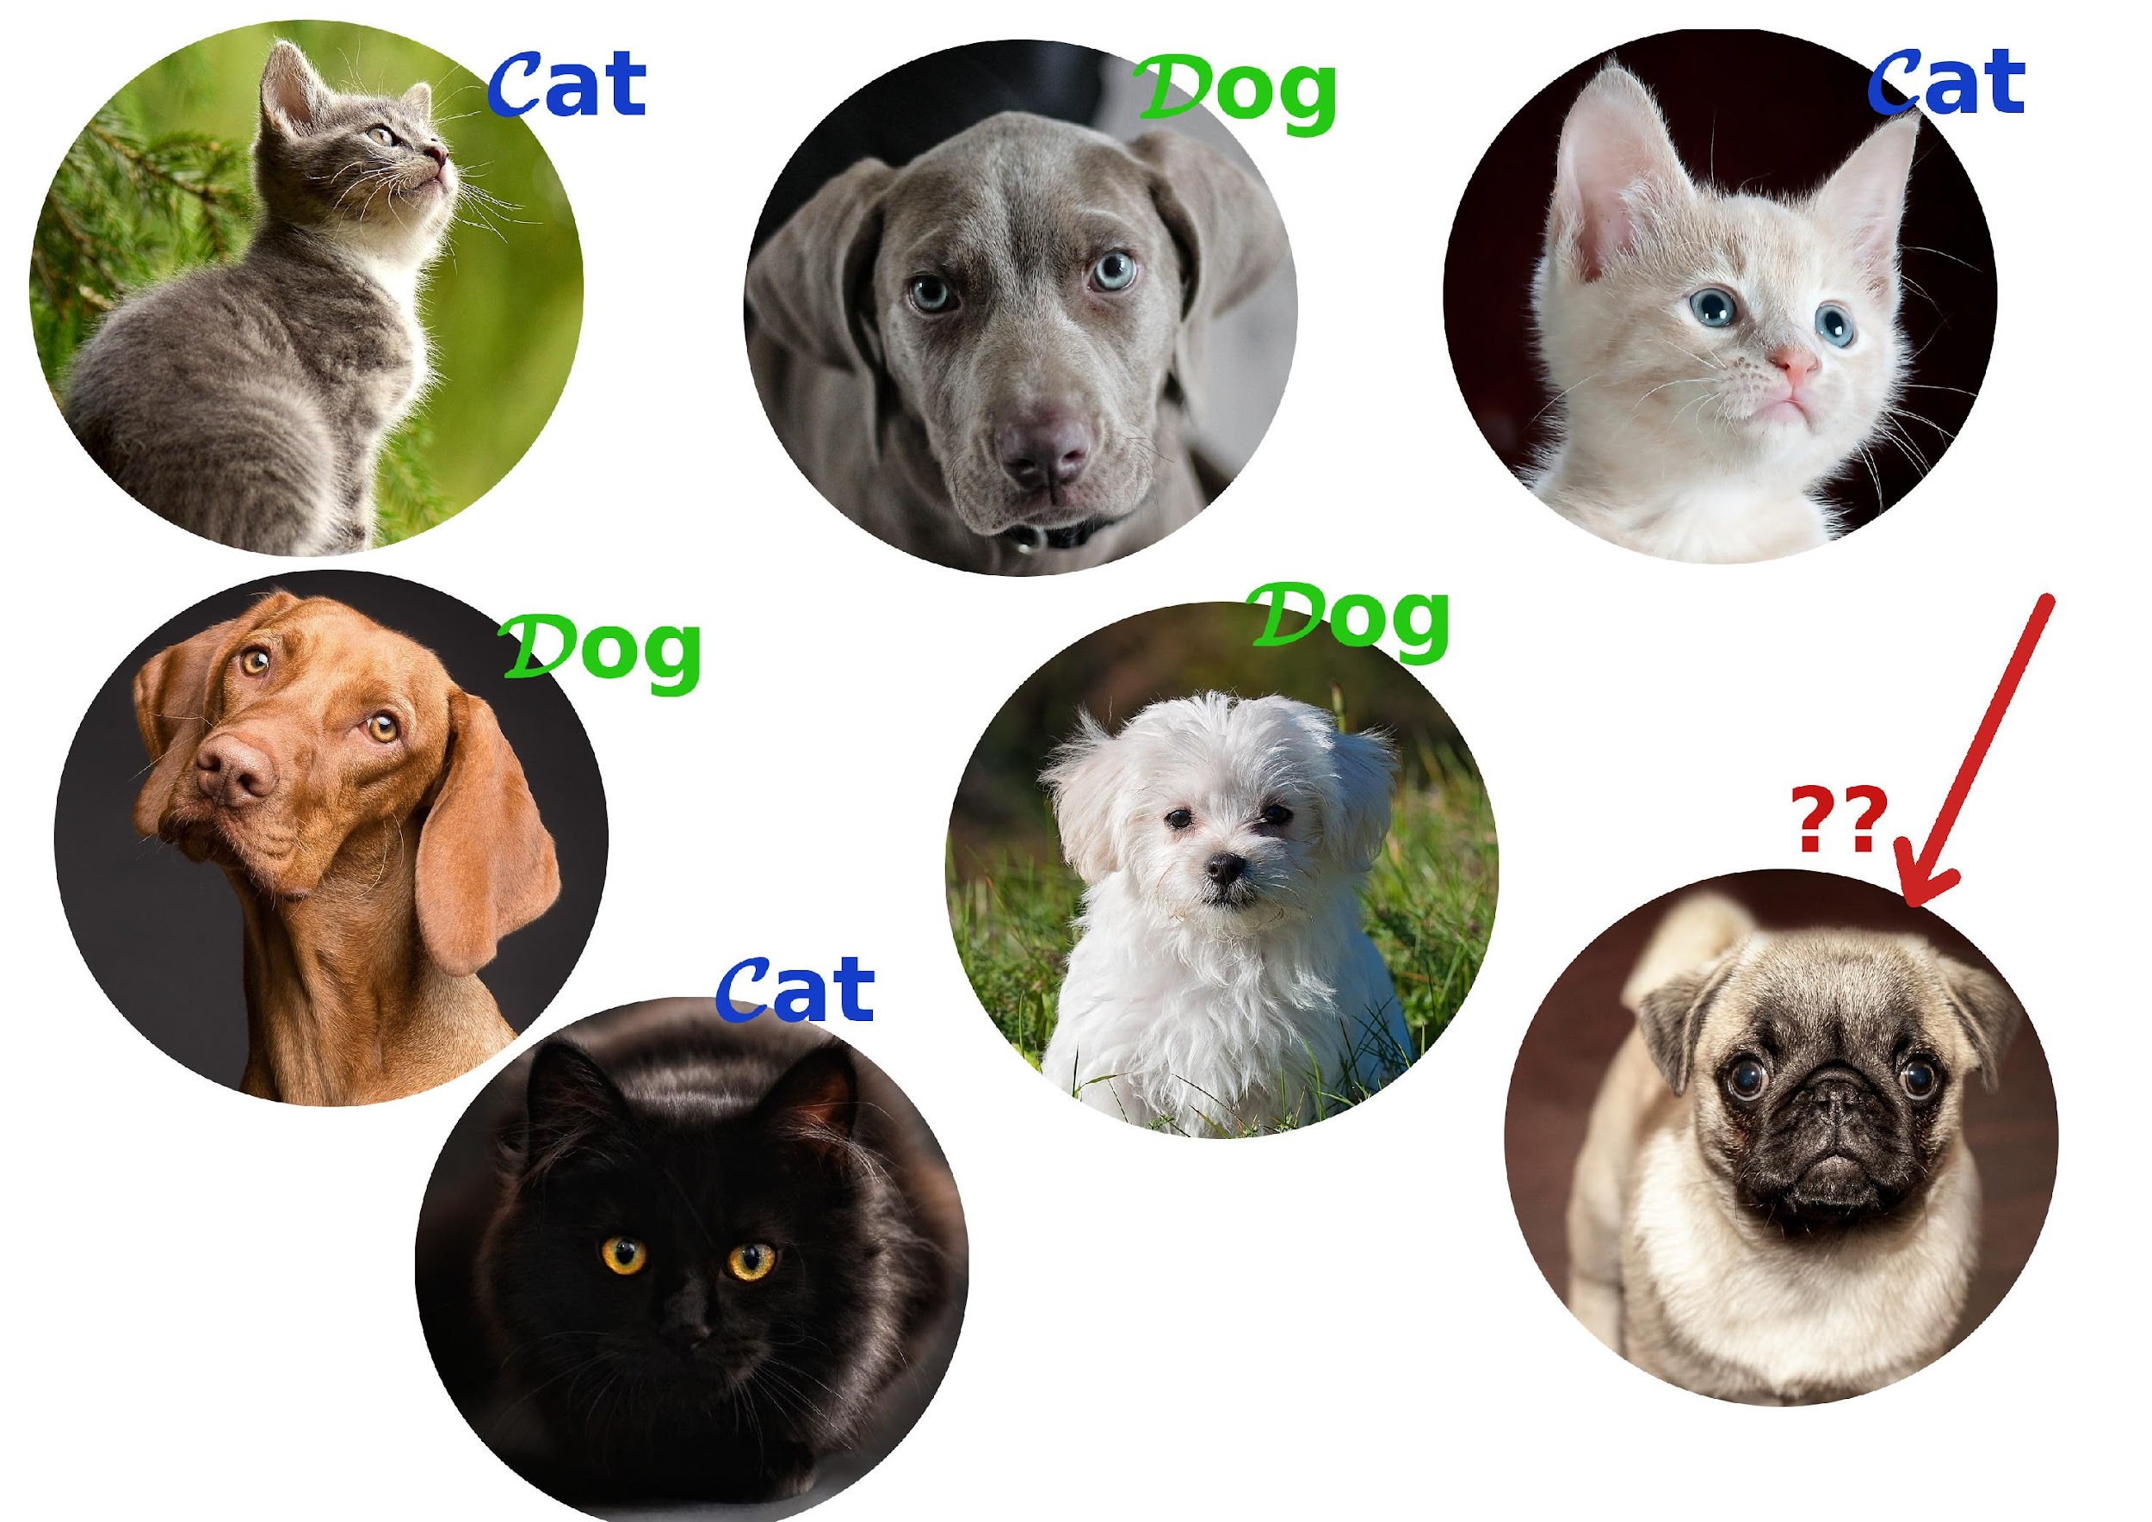
MACHINE LEARNING
Machines ‘experience’ by being given data – examples of inputs and the desired outcomes.
A machine can be shown thousands of images labeled “cat” or “dog”.
As the machine processes more data, it starts noticing patterns.
It may notice that cats usually have certain shapes and colors.
Over time, with enough examples, it improves its predictions by using these patterns.

Slide 8


MACHINE LEARNING
Just like humans learn from feedback (e.g., “That was a great dish!” or “Try adding more salt”), machines also get feedback.
When they make a mistake, they adjust by updating their “rules” to improve next time.

Slide 9
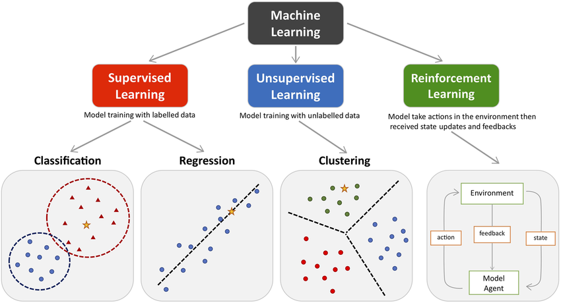
TYPES OF MACHINE LEARNING
Broadly categorized in three types
Supervised Learning
Unsupervised Learning
Reinforcement Learning

Slide 10



SUPERVISED LEARNING
SUPERVISED LEARNING IS LIKE HAVING A TEACHER GUIDING THE MACHINE.
THE MACHINE IS GIVEN LABELED DATA, WHICH MEANS EACH EXAMPLE HAS A KNOWN ANSWER (OR LABEL).
THE GOAL IS FOR THE MACHINE TO LEARN FROM THESE EXAMPLES AND MAKE PREDICTIONS ON NEW, UNSEEN DATA.

Slide 11
SUPERVISED LEARNING
Imagine you're teaching a child to recognize animals.
You show them a picture of a cat and tell them, "This is a cat."
You repeat this with more pictures until they can identify cats on their own.
In supervised learning, we give the machine similar examples—like labeled images—and the machine learns the patterns that connect the input (the image) with the output (the label).

Slide 12
UNSUPERVISED LEARNING
Unsupervised learning is like exploring without a map.
The machine is given unlabeled data, meaning there’s no predefined answer to guide it.
Instead, it has to find patterns or structure in the data on its own.

Slide 13



UNSUPERVISED LEARNING
Imagine you have a bunch of photos of animals, but you don’t know which animals are in the pictures.
The machine’s job is to group similar photos together (e.g., all cats in one group, all dogs in another) without being told the labels.
The machine looks for similarities in the data, like colors, shapes, or patterns, and organizes the data accordingly.

Slide 14


REINFORCEMENT LEARNING
REINFORCEMENT LEARNING (RL) IS LIKE TEACHING A PET THROUGH REWARDS AND PUNISHMENTS.
INSTEAD OF SHOWING THE MACHINE EXAMPLES WITH ANSWERS, WE LET IT INTERACT WITH AN ENVIRONMENT, WHERE IT TAKES ACTIONS AND GETS FEEDBACK IN THE FORM OF REWARDS (POSITIVE FEEDBACK) OR PENALTIES (NEGATIVE FEEDBACK).

Slide 15



REINFORCEMENT LEARNING
Imagine you’re teaching a dog a new trick.
You give it a treat when it does the trick correctly (reward), and you don’t when it gets it wrong (penalty).
Over time, the dog learns to repeat the trick to get more treats.
In RL, the machine interacts with its environment, tries actions (like moving or making decisions), and receives rewards or penalties. The goal is to maximize the total reward over time.

Slide 16

AI/ML TOOLS, LIBRARIES, AND SOFTWARES
AI and machine learning require powerful tools and libraries to build models, train them, and deploy them for real-world use.
These tools make it easier to handle data, run algorithms, and improve the performance of models.

Slide 17

DEVELOPMENT ENVIRONMENTS
Developers utilize integrated development environments (IDEs), cloud platforms, and other tools to design, train, and optimize machine learning models.
Jupyter Notebooks
An open-source web application that allows you to create and share documents that contain live code, equations, visualizations, and narrative text.
Google Colab
A free cloud service for running Jupyter notebooks with access to powerful GPUs, ideal for machine learning projects.
Anaconda
A popular distribution for Python and R, it includes a lot of tools and libraries to make data science and machine learning easier.

Slide 18
POPULAR TOOLS AND LIBRARIES
A wide range of specialized software tools exist for building and deploying AI and machine learning models.
TensorFlow
Developed by Google, it’s one of the most widely used libraries for building machine learning and deep learning models. It supports both research and production-level AI.
PyTorch
Developed by Facebook, it’s known for its ease of use and flexibility, especially in research. PyTorch is preferred for tasks that require a lot of custom experimentation.
scikit-learn
A simple and efficient library for data mining and machine learning. It’s great for beginners and used for tasks like classification, regression, and clustering.
Keras
A high-level API that runs on top of TensorFlow, making it easier to build deep learning models with less coding.
XGBoost
A highly efficient library for boosting algorithms, popular in competitions like Kaggle due to its speed and performance.

Slide 19

PREDICTION PROBLEM
Prediction in machine learning is like trying to guess the future!
The idea is to forecast or estimate a number based on patterns in past data.

Slide 20
PREDICTION PROBLEM
How Does It Work?
We have past data (like how much people bought in a store last month).
We use this data to train the machine to learn the patterns.
After learning, the machine can predict what will happen in the future (e.g., how many items will be sold next month).

Slide 21

PREDICTION PROBLEM
Imagine you want to know how much your house might sell for.
You have data on houses that were sold before—like their size, number of rooms, and location.
The machine learns from these examples and can predict the price of a new house you want to sell.

Slide 22
PREDICTION PROBLEM
Common Tools & Methods
Linear Regression
This method helps us draw a straight line to predict how things change. For example, it could predict that house price goes up as the size of the house increases.
Decision Trees
Think of it like a flowchart—if the house has more than 3 bedrooms, it might cost more.
Random Forests
Imagine several decision trees working together to make a better prediction!

Slide 23
PREDICTION PROBLEM - EXAMPLE
https://colab.research.google.com/drive/14L8nnszHvimrWAoYNG2WDbVrNb9Cd6oG

Slide 24
CLASSIFICATION PROBLEM
Classification is about sorting things into categories.
The goal is to take an input and assign it to a specific class.

Slide 25
CLASSIFICATION PROBLEM
How Does It Work?
The machine is trained with examples (input data with known categories).
For instance, we might show the machine several emails that are labeled as "spam" or "not spam".
After learning, the machine can then predict whether a new email is spam or not based on its features (like specific words or phrases).

Slide 26
CLASSIFICATION PROBLEM
Common Tools & Methods
Logistic Regression:
This simple method is great for problems where you have two categories (e.g., spam or not spam).
K-Nearest Neighbors (KNN)
This method checks how similar a new email is to others and classifies it based on the nearest examples.
Support Vector Machines (SVM)
This technique finds the best way to separate two groups, like drawing a line between spam and non-spam emails.

Slide 27
CLASSIFICATION PROBLEM – EXAMPLE
https://colab.research.google.com/drive/1bCHwUXkHKQTZ7RaUAFpDwNWPXx-C51Ga

Slide 28
CLUSTERING IN ML
Clustering is about grouping similar things together based on their features—without having any predefined labels.
It's like finding hidden patterns in data!

Slide 29
CLUSTERING IN ML
How Does It Work?
In clustering, we give the machine data without labels (just the features).
The machine then looks at the features and tries to group similar items together.
It’s like organizing your clothes into different piles (e.g., shirts, pants) without knowing in advance how many piles there should be.

Slide 30
CLUSTERING IN ML
Common Tools & Methods:
K-means Clustering
This algorithm divides the data into a specified number of groups (or clusters) based on how similar the items are to each other.
DBSCAN (Density-Based Clustering)
This method identifies clusters of varying shapes and sizes and can handle noise or outliers.
Hierarchical Clustering
Creates a tree-like structure to group data, useful for organizing data into multiple levels of hierarchy.

Slide 31

APPLICATIONS OF AI/ML
AI and machine learning are not just theoretical concepts—they are actively transforming many industries, improving efficiency, decision-making, and user experiences. Let’s look at some key applications!

Slide 32
HEALTHCARE
Predictive Analytics: AI can predict patient outcomes based on historical data, like predicting the likelihood of a disease.
Medical Imaging: ML models can help doctors detect conditions like cancer from medical images (e.g., MRI, X-ray) with greater accuracy.
Personalized Treatment: Machine learning can be used to recommend treatments based on a patient's medical history and genetic information

Slide 33
FINANCE
Fraud Detection: AI can analyze transaction patterns to detect unusual behavior and prevent fraud.
Algorithmic Trading: Machine learning algorithms analyze market data in real-time to make investment decisions.
Credit Scoring: AI models assess the risk of lending to individuals based on their financial history and other factors.

Slide 34
RETAIL & E-COMMERCE
Personalized Recommendations: Platforms like Amazon use machine learning to recommend products based on past purchases and browsing behavior.
Inventory Management: AI helps predict demand and optimize stock levels, reducing overstocking or stockouts.
Customer Sentiment Analysis: ML models analyze customer reviews and feedback to gauge customer satisfaction.

Slide 35
AUTONOMOUS SYSTEMS
Self-Driving Cars: ML and computer vision enable cars to drive themselves, analyzing the environment and making decisions in real-time.
Drones: AI helps drones navigate and complete tasks like delivery or surveillance autonomously.

Slide 36
NATURAL LANGUAGE PROCESSING (NLP)
Chatbots & Virtual Assistants: AI-powered assistants like Siri or Alexa use NLP to understand and respond to user queries.
Language Translation: Machine learning enables real-time translation of languages (e.g., Google Translate).
Sentiment Analysis: ML models analyze text (e.g., social media posts, reviews) to determine the sentiment (positive, negative, neutral).

Slide 37
THANK YOU.

